Slide 1
Bank Contingent Capital: Valuation and the Role of market discipline
周蕾

Slide 2
1.Introduction
Contingent capital notes(CCN)—contingent convertibles(CoCos)
Subordinated debts(SD)
Basel Ⅲ: all non-common equity instruments must incorporate a mandatory write-down or conversion feature if issued by an international active bank.

Slide 3
1.Introduction
Previous literature has mainly focused on stock price trigger.
All existing CCN so far rely mainly on accounting trigger.
The extant literature of CCN fails to investigate how the regulatory closure rule towards weakly-capitalized banks affects the valuations of CCN and SD and their role as market instruments in disciplining bank risk.
The goal of this paper is to value CCN and SD under regulatory closure rules and to investigate the roles of CCN and SD as market instruments in disciplining bank risk.

Slide 4
1.Introduction
The regulatory closure threshold is lower than capitcal ratio trigger
If regulators decide to intervene early before the capital ratio trigger is pulled
The regulatory closure threshold may have been negative, it may not affect CCN, but will affect the payoffs of SD.

Slide 5
1.Introduction
First, incorporate the regulatory closure rule into a multi-period structural model.
Help to identify the optimal size of CCN and optimal capital ratio trigger for each bank.
Use SD as a benchmark to analyze CCN and then compare
Take into account stochastic interest rates and jump risk of the banks assets.

Slide 6
1.Introduction
Second, the closed-form expression of CCN and SD in the simple Merton-style model by assuming defaults can only happen at the pre-specified auditing times.
A mixed capital structure of SD for CCN swap.
Observe the convex relationship between the price and capital ratio trigger of CCN.

Slide 7
1.Introduction
Thirdly, our numerical results in the more general model show that SD and CCN are affected very differently by diffusion volatility and crisis frequency risk.
Prices of CCN are more sensitive to issuing banks risk than SD.
Interesting policy implication.
CCN are more effective in terms of enhancing market displicine.
When regulatory closure threshold is incorporated and is higher than the trigger, as the size of CCN rises, the impact of crisis frequency on equity is stronger and the banks incentive to take on crisis risk decreases, whereas the incentive to take on more diffusion risk increses.

Slide 8
2.A structural model for pricing contingent capital notes
The structural approach is used to model a bank that issues short-term deposits, longer-term bonds, and common shareholders’ equity.
Mix= w₁*CCN+(1-w₁)*SD
w₁ is the ratio of CCN out of CCN and SD.

Slide 9
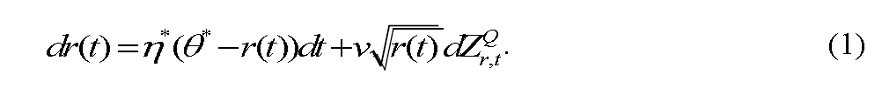
2.1 The Interest rate dynamics
The dynamics of the interest rate process under the risk-neutralized pricing measure Q are:

Slide 10
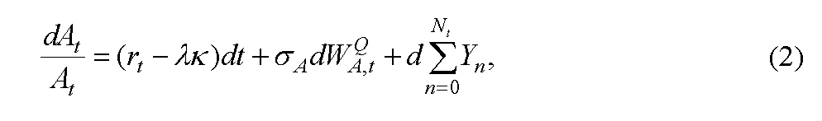
2.2 The asset dynamics
To capture the effect of the interest rate risk and jump risk on the banks assets
Adopt the jump diffusion model and consider the correlation between the diffusion process of the value of a banks assets and the interest rate.
Specifically, under the risk-neutralized measure Q, the value of a banks assets is governed by the following process:

Slide 11
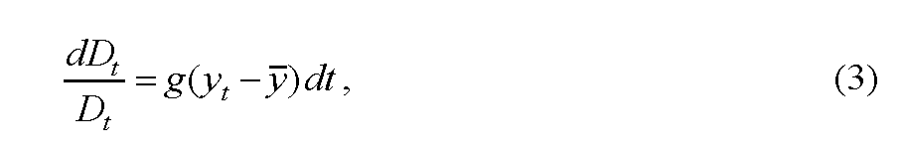
2.3 The deposit dynamics
Assume that the banks deposits are covered by deposit insurance and the dynamics of the bank’s deposits have a mean-reverting trend towards a target capital ratio.

Slide 12
3. Valuation of Contingent capital notes and Subordinated debt
In accordance with periodic examinations of capital adequacy by regulators, we assume that the time interval is six months.
In other words, CCN and SD may be triggered at any semiannual point of time before their maturity.
Auditing time: t_{i}
Maturity day: T
Coupon rate: c

Slide 13
3.1 multi-period contingent capital notes
In order to be consistent with the contract designs of recent transactions, this study assumes that the CCN will be used to write down the bank’s losses first if the capital ratio is triggered.
The loss-absorbing amount, if sufficient, will bring the bank’s capital position up to the level of the required capital ratio.
In case there is a residual amount after meeting the required capital ratio, the residual amount will be converted into equity shares at the market price of the triggering time.

Slide 14
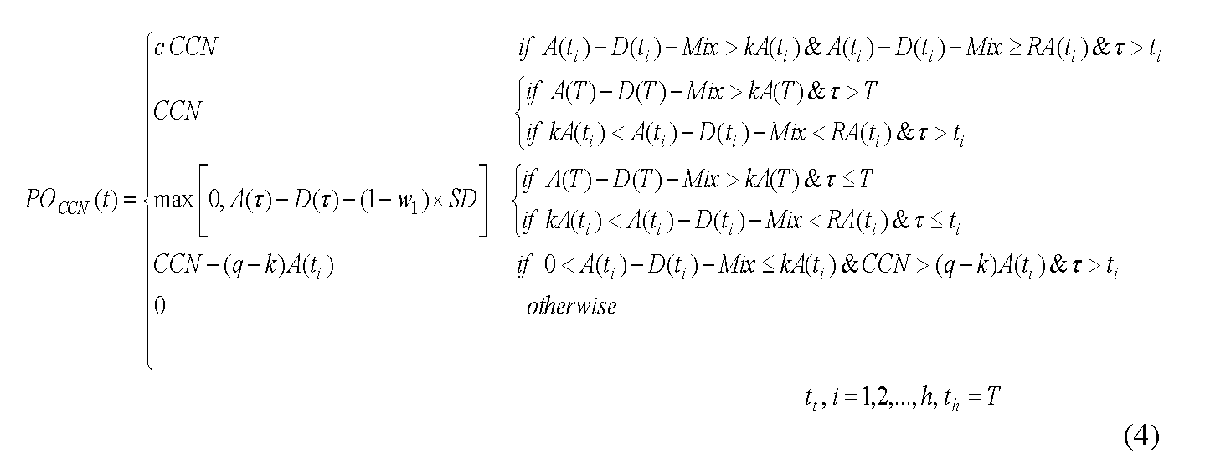
3.1 multi-period contingent capital notes
Payoffs of CCN

Slide 15
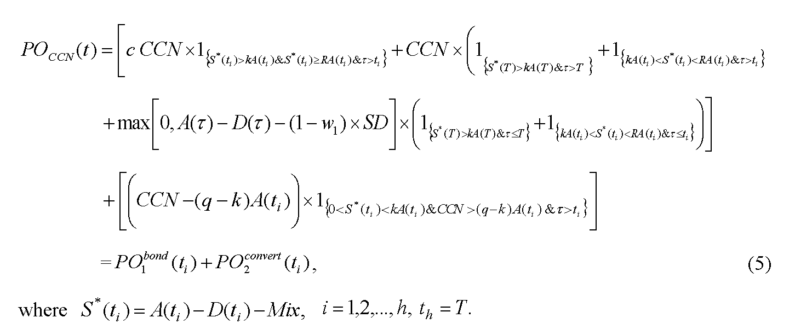
3.1 multi-period contingent capital notes
Rewrite the equation:

Slide 16
3.1 multi-period contingent capital notes
payoff of CCN at time t can be decomposed into two components.
The first term, PO1-bond , is the value of the coupon bond when CCN are not triggered.
The second term, PO2-convert , is the value of new equity shares that the CCN are converted into after absorbing the losses.

Slide 17
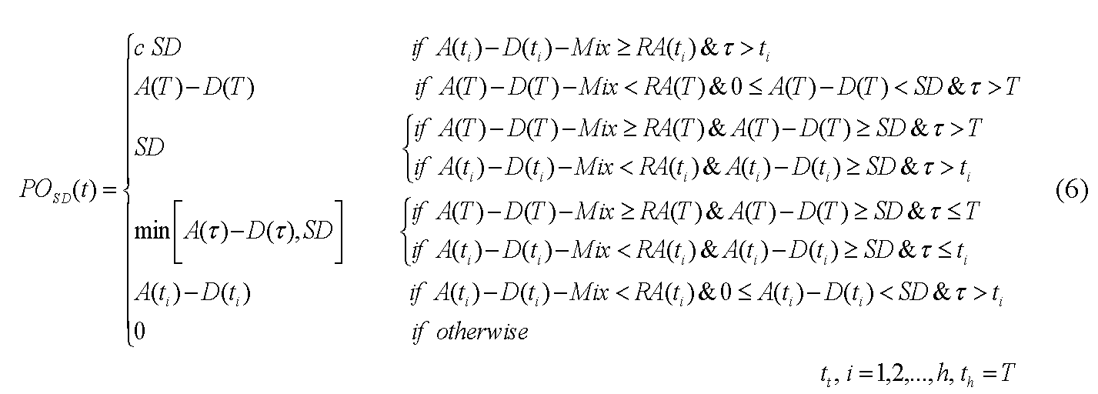
3.2 multi-period subordinated debt
Payoff of SD

Slide 18
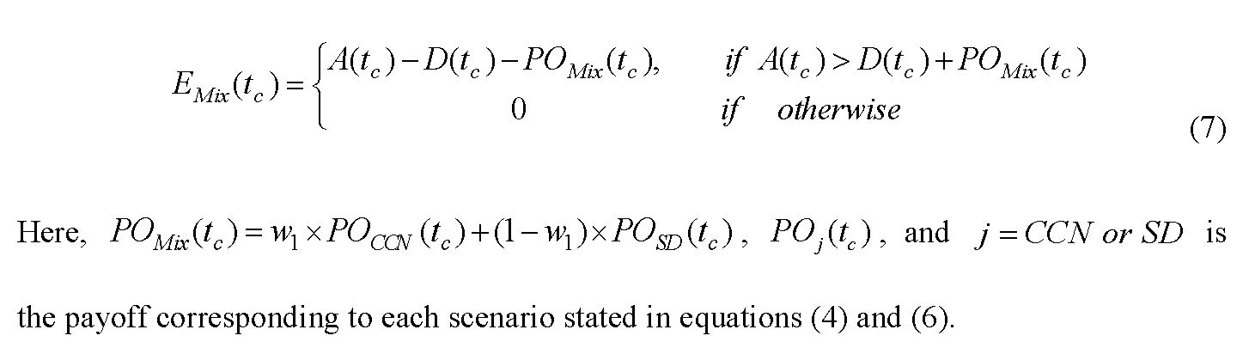
3.3 original sharehold equity
The value of the original shareholders equity at closure time, conversion time, or default time tc:

Slide 19
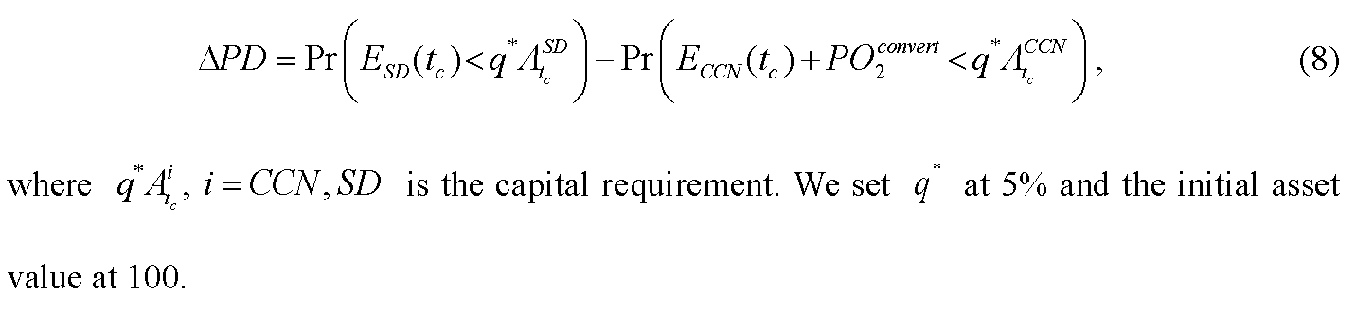
3.4 improved PD
the probability of default (PD) is defined as the probability that the shareholders equity E(tc) is less than the capital requirement at the time of either closure, conversion, or default.
compute the banks PD taking SD as the long-term debt minus the banks PD and with CCN as the long-term debt in order to measure the improved default probability, deltaPD.

Slide 20
3.5 regulatory closure rules
capital ratio trigger (k) VS The threshold rate (R)
R>k, closed before trigger. CCN become subordinated debt when the banks capital position is higher than the trigger ratio, but the threshold still determines their maturities and payoffs, and consequently their prices.
R<k, the trigger ratio determines the maturities and payoffs of CCN rather than the closure threshold.

Slide 21
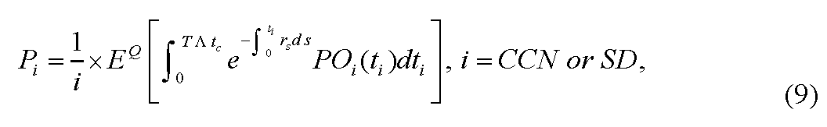
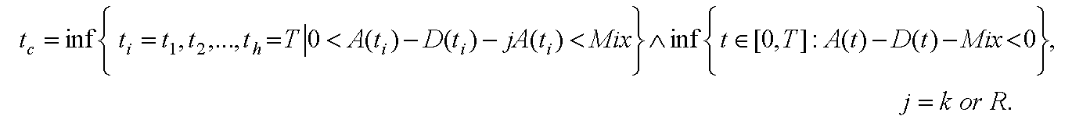
3.6 price of CCN and SD
the values of CCN and SD on the issuing date (i.e., time 0) under the risk-neutralized pricing measure as follows:
Tc denotes the timing of the first trigger, closure, or default and is defined as:

Slide 22
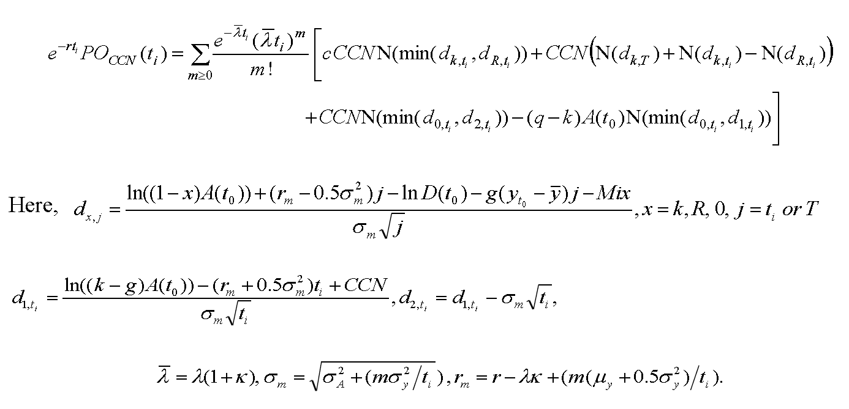
4. Analytical and Numerical Results
The closed-form formula of the present value of CCN at auditing time

Slide 23
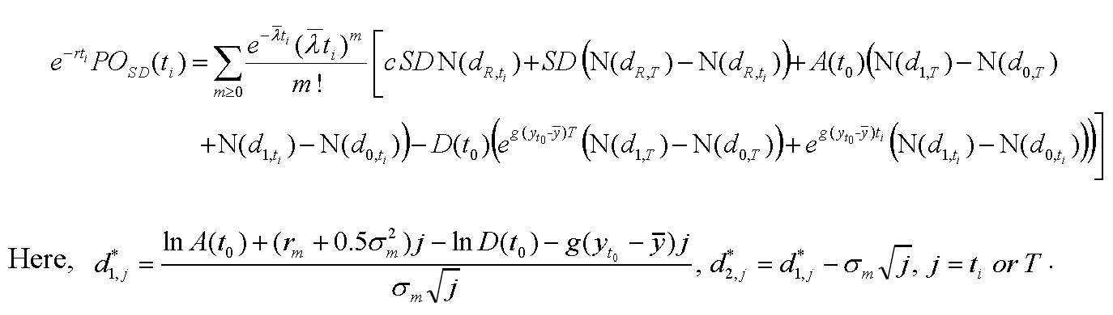
4.1 Analytical Expressions
The closed-form formula of the present value of SD at auditing time

Slide 24
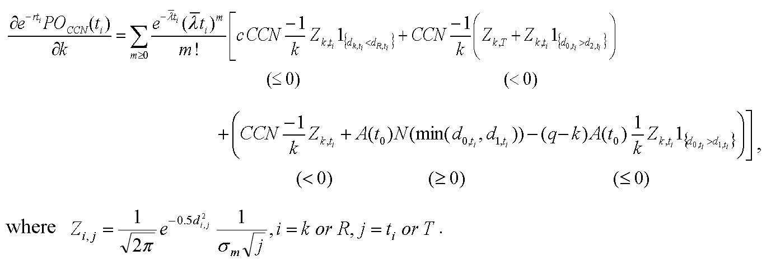
4.1 Analytical Expressions
The immediate impact of granting a higher capital ratio trigger k is best demonstrated by the following derivative property

Slide 25
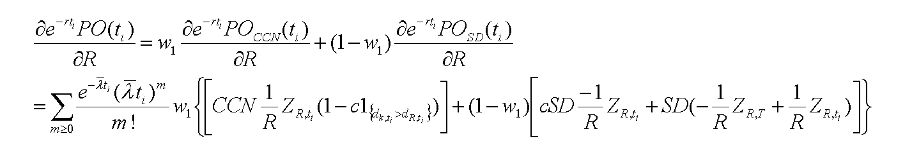
4.1 Analytical Expressions
taking the first partial derivative of R
the sign is uncertain. So consider some special cases

Slide 26
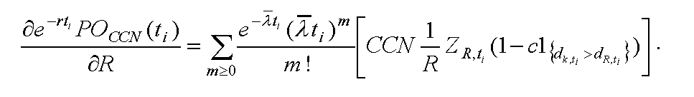
4.1 Analytical Expressions
W1=1, only CCN.

Slide 27
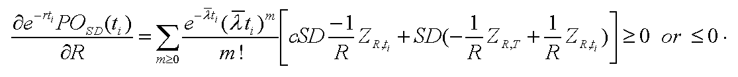
4.1 Analytical Expressions
W1=0, only SD.

Slide 28
4.1 Analytical Expressions
W1=0.5, equal amount

Slide 29
4.2 numerical analysis
Parameter value(table 2)
Simulated prices of CCN and SD (table 3/4)
Capital Ratio Trigger, Size of CCN, and the Original Shareholders’ Equity (figure 1/2)
Probability of Default (PD) (figure 3)
Regulatory Closure Rule and Crisis Frequency (figure 4/5/6/7)
Regulatory Closure Rule and Asset Diffusion Volatility (figure 8/9/10/11)
Regulatory Closure Rules and CCN for Equity Swap (figure 12/13)

Slide 30
5. Conclusion
contribution: incorporate the regulatory closure rule into a multi-period structural model for CCN and SD.
a convex relationship between the price and the capital ratio trigger of CCN.
on the general model, the size of CCN increases the price of CCN.
frequency of auditing information: monthly power than yearly.
a lower regulatory closure threshold (capital forbearance) increases (decreases) the price (yield spread) of SD, but not that of CCN.

